Slide 1
Implementing AI Governance Framework in Organization - Why now?
Ana Chubinidze
Founder & CEO, Adalan AI & AI Governance International

Slide 2
AI Market is expected to grow up to $300 billion by 2026
Governance frameworks are rarely in place.

Slide 3
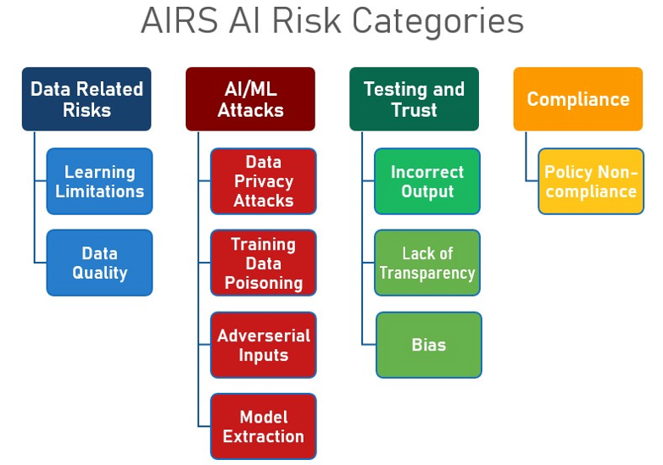


Slide 4

Most-cited reasons
1. 'We don’t have to'
2. 'It’s too soon'
3. 'No one else is doing it'
4. 'It’s someone else's job.'
5. 'We can’t afford it'
6. 'We don’t know how'

Slide 5
A-Level Algorithm
Why did it happen?
Incompetence: Purpose and the context of the technology was not well thought after.
Negligence: Various actors have not been consulted. Adequate impact assessment has not been conducted.
Emerging field: Lack of best practice examples and standards.
What happened?
Impact: One team with several decision-makers affected the future of thousands of students.
Reputation: Public trust in government, in company, and in technology diminished
Accountability: Project manager resigned

Slide 6


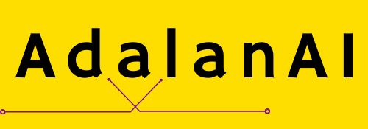
Think within and outside of the box
AIGovBox
Ethical Principles and Case-by-Case Study
Fit for Purpose
Data Quality and Privacy
Fairness and Non-discrimination
Transparency and Explainability
Continuous Human Oversight
Safety and Robustness
Accountability

Slide 7
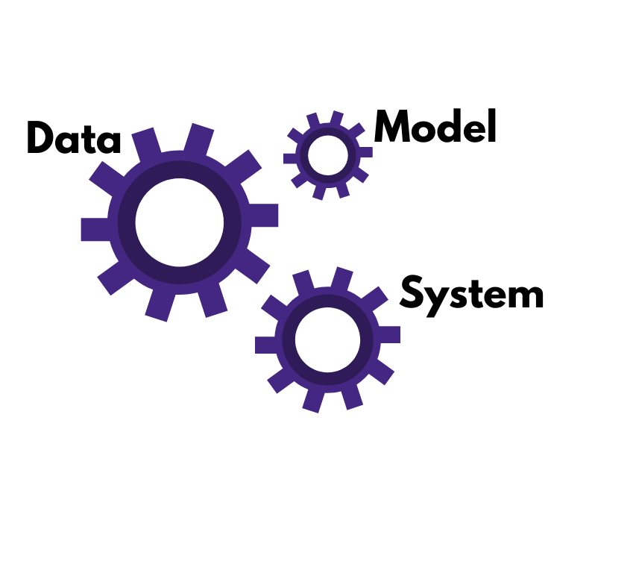
Think within and outside of the box
AIGovBox
Ethical Principles and Case-by-Case Study
Fit for Purpose
Data Quality and Privacy
Fairness and Non-discrimination
Transparency and Explainability
Continuous Human Oversight
Safety and Robustness
Accountability

Slide 8
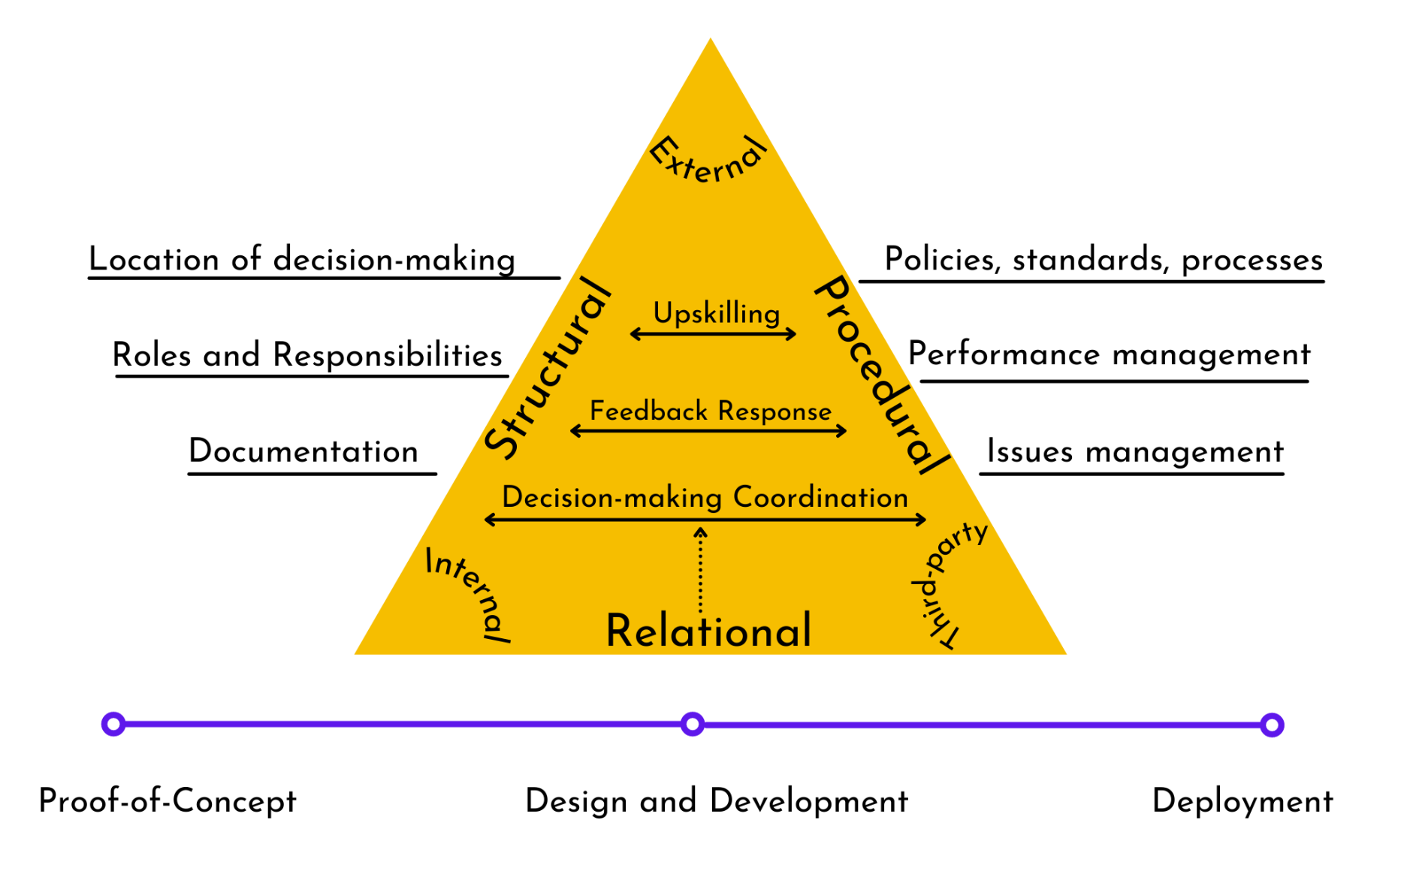
From ‘What’ to ‘How’

Slide 9
Thank you!
Contact:
ana.chubinidze@adalanai.com
https://www.linkedin.com/in/anachubinidze/

